Slide 1
Year 6 Residential
Thorpe Woodlands

Slide 2
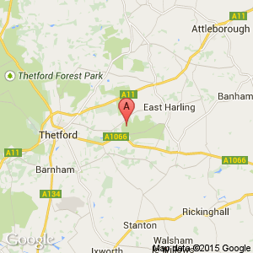
Where is Thorpe Woodlands?

Slide 3
Site layout

Slide 4
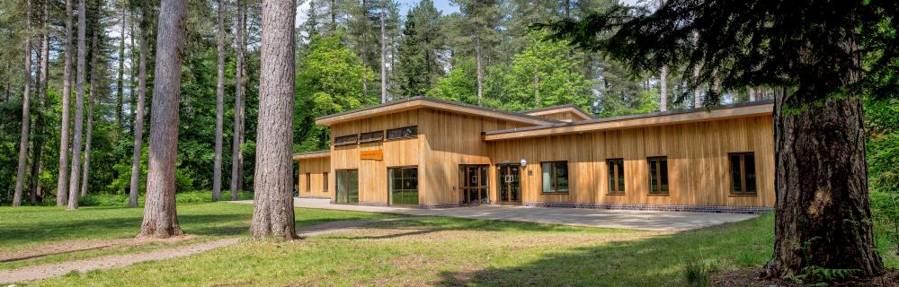
Thorpe Woodlands Centre

Slide 5
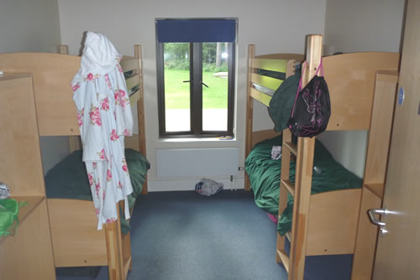
Bedrooms

Slide 6
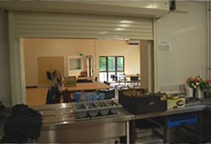
Meal times

Slide 7
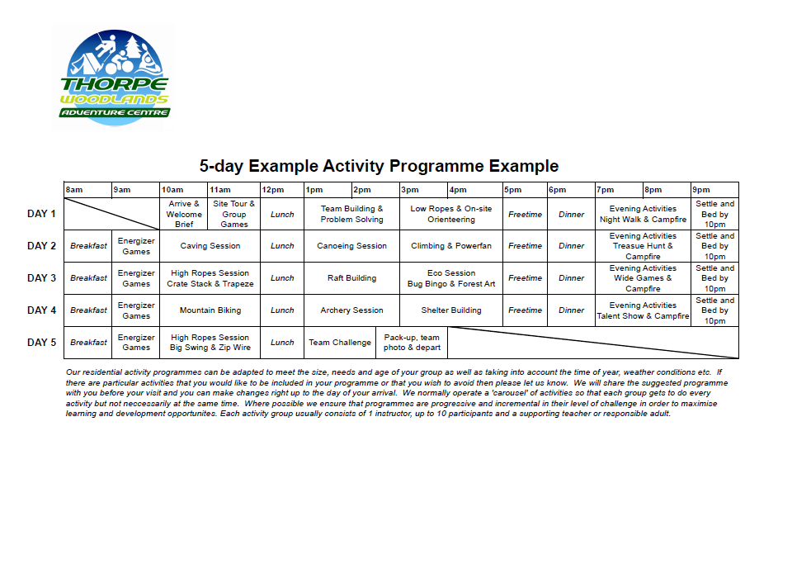
5 day programme

Slide 8
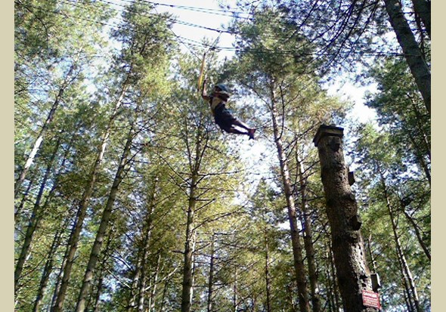
High level activities

Slide 9
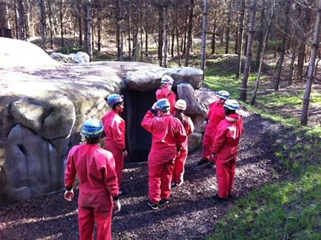
Team building

Slide 10

Thorpe Woodlands Website

