Slide 1
Maths KS2 Parent Workshop
November 2023

Slide 2
Why Mathematics?
Concepts, skills and thinking strategies that are essential in everyday life - such as time
It helps children make sense of the numbers, patterns and shapes they see in the world around them
Handling data in an increasingly digital world and makes a crucial contribution to their development
Children delight in using mathematics to solve a problem, especially when it leads them to an unexpected discovery or new connections - success
As their confidence grows, they look for patterns, use logical reasoning, suggest solutions and try out different approaches to problems - challenge
Mathematics offers children a powerful way of communicating. They learn to explore and explain their ideas using symbols, diagrams and spoken and written language
They start to discover how mathematics has developed over time and contributes to our economy, society and culture
Studying mathematics stimulates curiosity, fosters creativity and equips children with the skills they need in life beyond school

Slide 3
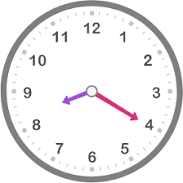
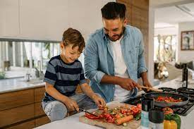
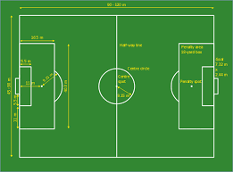
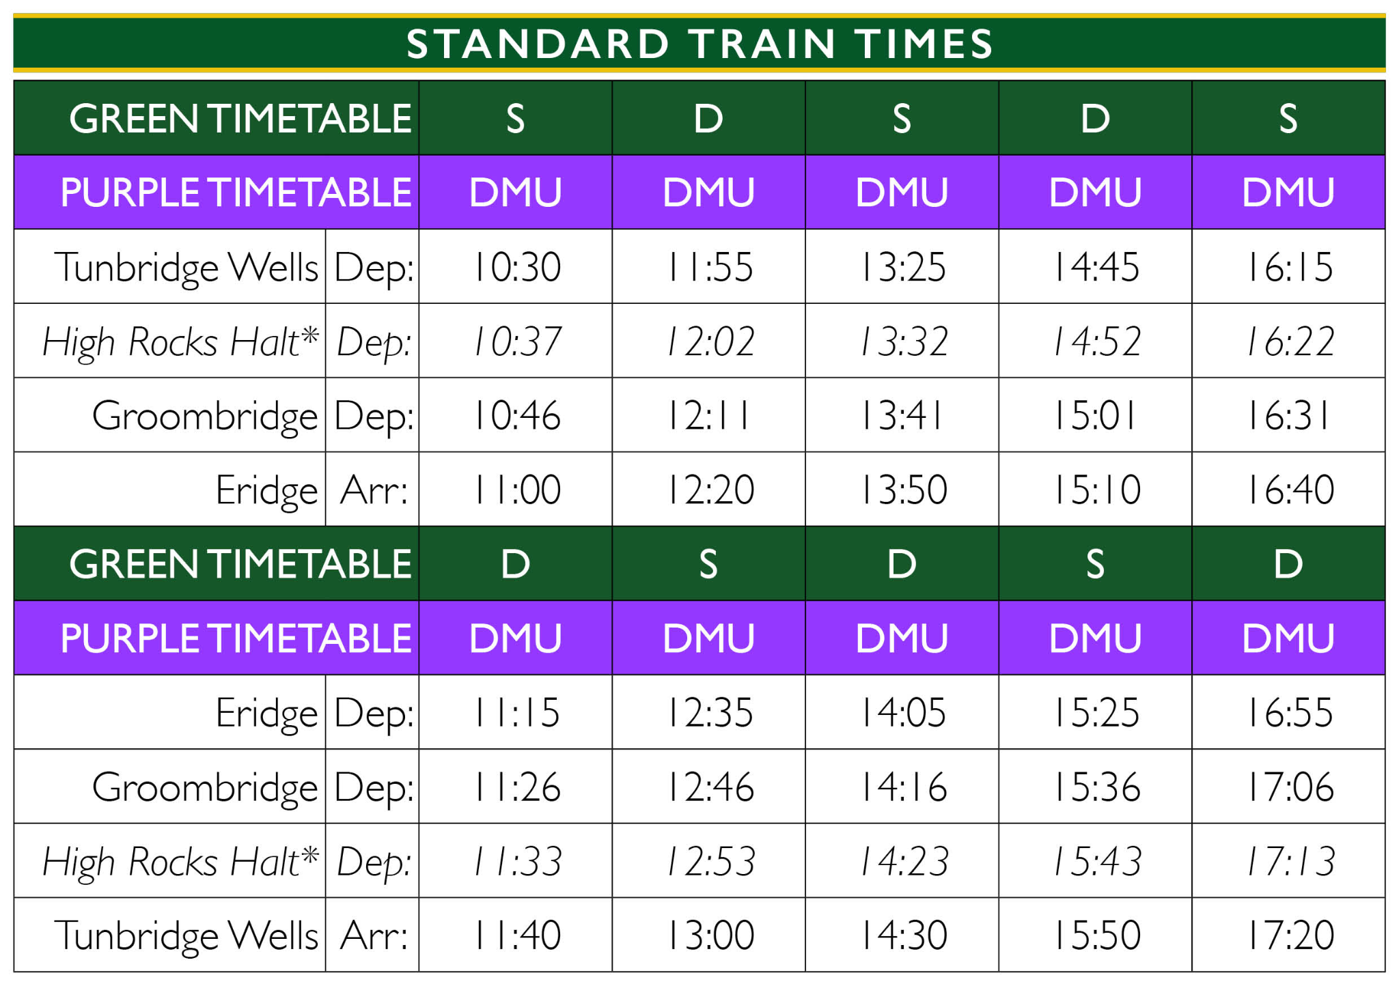
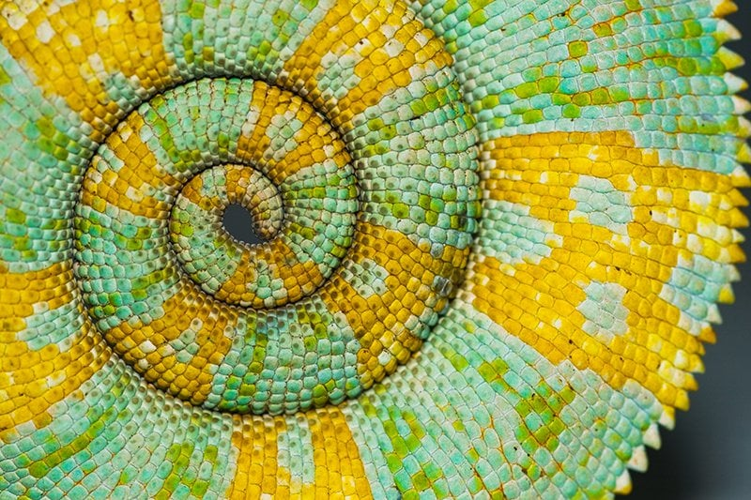
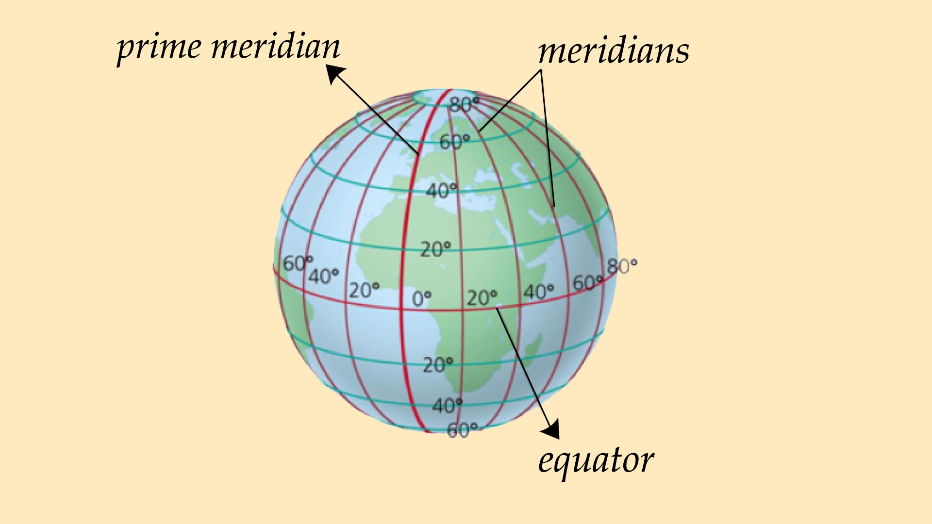
Real-Life Maths

Slide 4
Building on KS1
 | Place Value | Number
Year 1 | Count to and across 100, forwards and backwards, beginning with 0 or 1, or from any given number Count, read and write numbers to 100 in numerals; Given a number, identify one more and one less Identify and represent numbers using objects and pictorial representations including the number line, and use the language of: equal to, more than, less than (fewer), most, least Read and write numbers from 1 to 20 in numerals and words. | Read, write and interpret mathematical statements involving addition (+), subtraction (–) and equals (=) signs Represent and use number bonds and related subtraction facts within 20 Add and subtract one-digit and two-digit numbers to 20, including zero Solve one-step problems that involve addition and subtraction, using concrete objects and pictorial representations, and missing number problems such as 7 = – 9. Count in multiples of twos, fives and tens Solve one-step problems involving multiplication and division, by calculating the answer using concrete objects and pictorial representations.

Slide 5
Building on KS1
 | Place Value | Number
Year 2 | Recognise the place value of each digit in a two-digit number (tens, ones) Identify, represent and estimate numbers using different representations, including the number line Compare and order numbers from 0 up to 100; use <, > and = signs Read and write numbers to at least 100 in numerals and in words Use place value and number facts to solve problems. | Solve problems with addition and subtraction: using concrete objects and pictorial representations, including those involving numbers, quantities and measures Recall and use addition and subtraction facts to 20 fluently, and derive and use related facts up to 100 Add and subtract numbers using concrete objects, pictorial representations, and mentally, including: a two-digit number and ones a two-digit number and tens two two-digit numbers Adding three one-digit numbers show that addition of two numbers can be done in any order (commutative) and subtraction of one number from another cannot Recognise and use the inverse relationship between addition and subtraction and use this to check calculations Count in steps of 2, 3, and 5 from 0, and in tens from any number, forward and backward Recall and use multiplication and division facts for the 2, 5 and 10 multiplication tables.

Slide 6
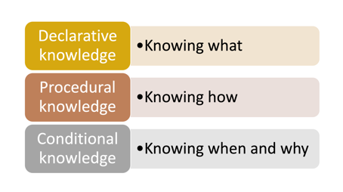
Years 3-6 Structures
Fix It Time
Warm up task (5-10 mins)
Anchor task/ Lesson Input
We Do - Guided Practice
Pre Fluency
You Do - Independent Application
Secure It - A bit more practice if required
Reasoning & Problem Solving
Limitless Learning
Maths Meeting/ Multiplication Meeting

Slide 7
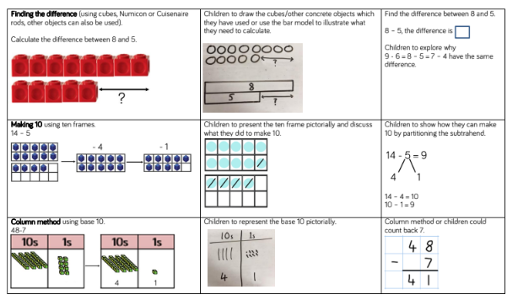
Calculation Policy

Slide 8
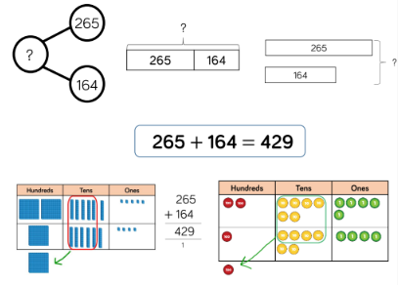
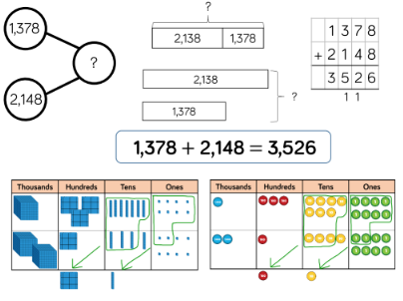
Place Value & Four Operations

Slide 9
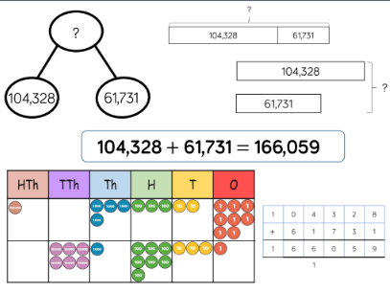
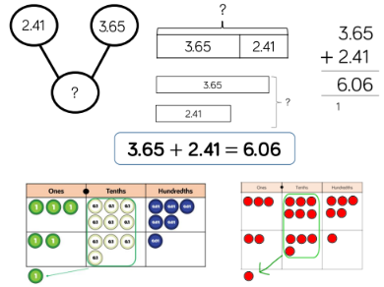
Place Value & Four Operations

Slide 10
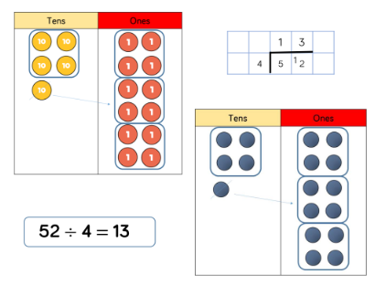
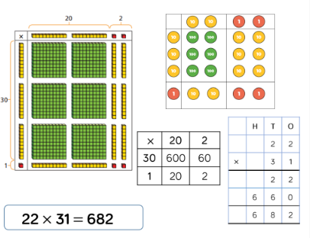
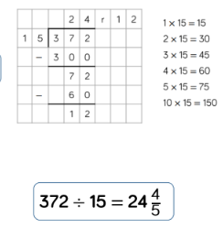
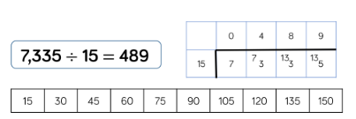
Place Value & Four Operations

Slide 11
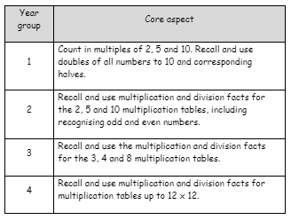
Multiplication Tables
Fundamental building block of many core areas of mathematical understanding.
Children who are fluent in multiplication tables free up working memory for other aspects of problem solving and calculation procedures.
Multiplication, division, fractions, ratio, proportion, algebra, BODMAS/BIDMAS.
As children progress throughout KS2, their mathematical learning will be hindered without fluent, speedy recall.
Access TTRS at least three times per week
Practice recall at home with mixed division facts.
Homework

Slide 12
Importance of Memory and Recall
Cognitive Load
Working Memory
Recall
Cognitive Overload
Key Instant Recall facts - KIRFs

Slide 13
Any Questions?

